Slide 1

Domain: MATLAB
Technology: COMMUNICATION
EEG Based Early Detection of Autism by Using SVM Classifier

Slide 2
Index
Abstract
Introduction
Literature review
Existing Method
Disadvantages
Proposed method
Advantages
Applications
Hardware and Software Requirements
Result
Conclusion
References

Slide 3
Abstract
Developmental impairment known as autism spectrum disorder (ASD) is brought on by variations in the brain. Some ASD sufferers have a recognised distinction, like a genetic disorder. Other factors are still unknown. ASD is thought to have a number of underlying reasons that interact to alter how people typically develop. Signals from electroencephalography (EEG) are recorded to study the activities of the brain. The frequency domain of an EEG signal can be used to extract properties like alpha, beta, gamma, delta, and theta, among others. These changes in frequency can be used to diagnose autism in children. Developmental impairment known as autism spectrum disorder (ASD) is brought on by variations in the brain. Some ASD sufferers have a recognised distinction, like a genetic disorder. Other factors are still unknown. ASD is thought to have a number of underlying reasons that interact to alter how people typically develop. Signals from electroencephalography (EEG) are recorded to study the activities of the brain. The frequency domain of an EEG signal can be used to extract properties like alpha, beta, gamma, delta, and theta, among others. These changes in frequency can be used to diagnose autism in children.

Slide 4
Introduction:
Autism
Autism spectrum condition severe developmental disorder that affects a person's capacity for interaction and communication. The neurological system is impacted by autism spectrum disorder, which also has an impact on the sufferer's general cognitive, emotional, social, and physical health. Symptoms can range significantly in scope and severity. Communication problems, social interaction problems, obsessional interests, and repeated behaviors are typical signs. Early detection and familial, behavioral, educational, and educational therapy may help to lessen symptoms and promote growth and learning.
Electroencephalography (EEG)
An electrogram of the brain's spontaneous electrical activity can be captured via electroencephalography (EEG). It has been established that the bio-signals picked up by EEG are postsynaptic potentials of pyramidal neurons in the neocortex and allocortex. With the International 10-20 system or variants of it, the EEG electrodes are typically placed along the scalp (commonly referred to as "scalp EEG"). The term "intracranial EEG" is occasionally used to refer to electrocorticography, which involves surgically implanting electrodes. The most common methods for clinically interpreting EEG recordings are visual inspection of the trace and quantitative EEG analysis.

Slide 5
Literature review:
S. NO | Journal Type with year | Authors | Title | Outcomes
1 | International journal of medical informatics 117: 112-124., 2018 | Thabtah, Fadi, Firuz Kamalov, and Khairan Rajab | A new computational intelligence approach to detect autistic features for autism screening | Studied about the autism detection using autistic features
2 | Journal of the American Academy of Child & Adolescent Psychiatry 46(12): 1668-1676, 2007 | Constantino, John N., Patricia D. Lavesser, Y. I. Zhang, Anna M. Abbacchi, Teddi Gray, and Richard D. Todd | Rapid quantitative assessment of autistic social impairment by classroom teachers | Studied about the Rapid quantitative assessment of autism
3 | Journal of autism and developmental disorders 45(5): 1121-1136., 2015 | Daniel Bone, Matthew S. Goodwin, Matthew P. Black, Chi-Chun Lee, Kartik Audhkhasi, and Shrikanth Narayanan | Applying machine learning to facilitate autism diagnostics: pitfalls and promises | Studied about Applying machine learning to facilitate autism
4 | Translational psychiatry, 2(4): e100., 2012 | Dennis Paul Wall, J. Kosmicki, T. F. Deluca, E. Harstad, and Vincent Alfred Fusaro | Use of machine learning to shorten observation based screening and diagnosis of autism | Studied about the ML based to shorten observation based screening and diagnosis of autism
5 | PloS one, 7(8): e43855, 2012 | Dennis P. Wall, Rebecca Dally, Rhiannon Luyster, Jae-Yoon Jung, and Todd F. DeLuca. | Use of artificial intelligence to shorten the behavioral diagnosis of autism | Studied about the use of AI to diagnose autism

Slide 6
Existing method:
A supervised machine learning approach called K-Nearest Neighbour records all instances that match training data points in n-dimensional space. For real-valued data, it returns the mean of the k nearest neighbours, and when an unknown discrete data is received, it analyses the closest k instances saved (nearest neighbours) and returns the most common class as the prediction. The distance-weighted nearest neighbour method uses the following query to weight each of the k neighbours contributions according to their distance, giving the closest neighbours more weight. Since KNN averages the k-nearest neighbours, it is typically resistant to noisy data. The k-nearest 1634 neighbours algorithm is a supervised classification system that uses a collection of 1634 neighbour points them to learn how to label other points.

Slide 7
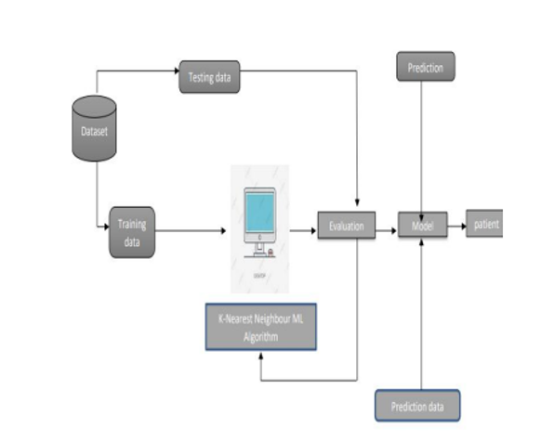
Fig: Block Diagram of Existing Method

Slide 8
Disadvantages in Existing method:
Always needs to determine the value of Kernel which may be complex some time.
The computation cost is high because of calculating the distance between the data points for all the training samples.

Slide 9
Proposed method:
The dataset is used to extract the EEG signals that both have and do not have autism. The dataset is sent for feature extraction, which uses instantaneous frequencies to extract the various aspects of an EEG signal. By default, the EEG signal stored in the dataset will be in the time domain; however, we must afterwards apply the Fourier Transform (FT) to convert it to the frequency domain. Then, the frequency domain signal will be used in the feature extraction procedure to extract the various features, including Alpha, Beta, and Theta. The features depict the fluctuations in the patient's brain when the signal is being captured, indicating the various emotions and stress the patient has experienced while the signal is being captured.

Slide 10
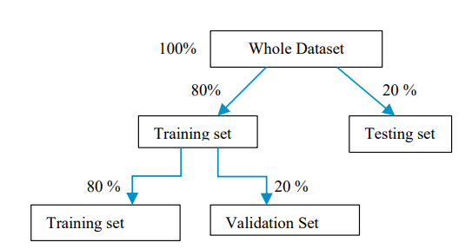
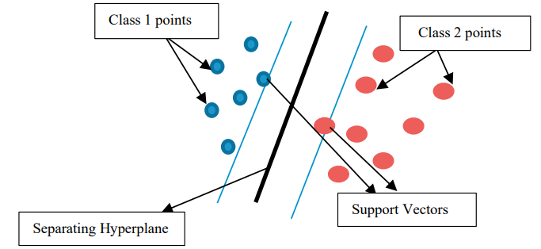
Fig: Flow of the proposed method

Slide 11
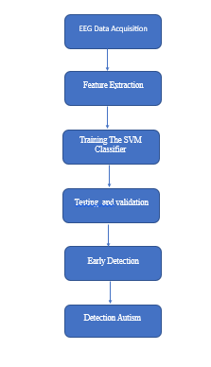
Fig: Flow of the proposed method

Slide 12
EEG Data Acquisition: EEG signals are acquired from the scalp using electrodes
and amplified.
Preprocessing: The raw EEG signals are preprocessed by removing noise,
artifacts, and other unwanted signals.
Feature Extraction: Various features are extracted from the preprocessed EEG \
signals, such as power spectral density, coherence, and entropy.
Feature Selection: Relevant features are selected from the extracted features to
improve the classification accuracy and reduce computational complexity.

Slide 13
Training the SVM Classifier: The selected features are used to train the SVM classifier
algorithm with labeled data from individuals with and without ASD.
Model Evaluation: The trained SVM classifier is evaluated using a validation dataset to
determine its accuracy, sensitivity, and specificity.
Early Detection: Once the SVM classifier algorithm is validated, it can be used for early
detection of ASD by analyzing the EEG signals of individuals at risk of developing ASD.
Intervention and Support: Early detection of ASD using EEG-based methods can help
In providing early intervention and support to individuals with ASD, which can improve
their long-term outcomes.
Overall, this block diagram outlines the main steps involved in using EEG-based methods
and SVM classifier algorithm for early detection of Autism.

Slide 14
Training
The classifier receives the features of the EEG signals of different patients. The dataset is divided into two sets, one is for training and other one is for testing. Initially, the training data is fed to the classifier where the classifier learns about the patterns to identify the autism based person and a non-autism based person. The more the data for training the more the accuracy, but, the more data for training will also increases the time for the completion of training too. So, we need to choose the better suitable features which can distinguish the two kinds of persons very clearly.
Testing
In this stage, the accuracy of the classifier that was trained in the prior training phase will be evaluated. Here, we will evaluate the classification accuracy of the classifier using some random testing data samples that we have first segregated. Because the classifier we're using in this case is a Binary SVM, the results of testing will be either a "0" or a "1". Later, the binary results must be translated into the labels that were initially fed to the classifier. The classifier's output underwent testing, and it gave very accurate predictions of the data. This proposed approach's test results have demonstrated an accuracy of over 90%, which is higher than the accuracy of the current method, which is greater than the existing method where they have classified using KNN classifier.

Slide 15
Advantages of Proposed method:
The SVM Classifier is better than existing KNN classifier.
Instantaneous frequencies based features really helped in maximizing accuracy.
The SVM classifier uses less data for training which decreases the training time.

Slide 16
Applications:
Applied in DSP applications.
EEG Based diseases Detection.
Bio-Medical Signal Processing.

Slide 17
Hardware and Software Requirements:
Hardware & Software Requirements:
Software: Matlab R2018a.
Hardware:
Operating Systems:
• Windows 10
• Windows 7 Service Pack 1
• Windows Server 2019
• Windows Server 2016
Processors:
Minimum: Any Intel or AMD x86-64 processor
Recommended: Any Intel or AMD x86-64 processor with four logical cores and AVX2 instruction set support
Disk:
Minimum: 2.9 GB of HDD space for MATLAB only, 5-8 GB for a typical installation
Recommended: An SSD is recommended a full installation of all Math Works products may take up to 29 GB of disk space
RAM:
Minimum: 4 GB
Recommended: 8 GB

Slide 18
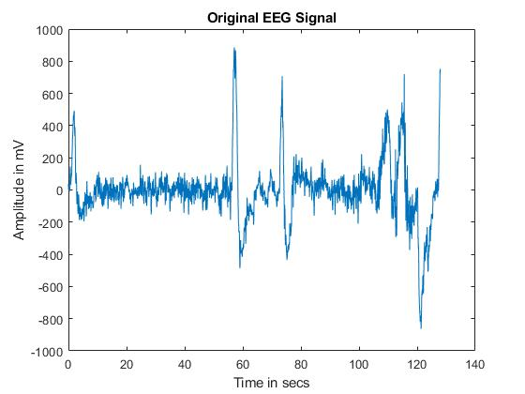
Result

Slide 19
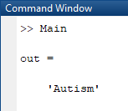
Fig: Classification Results

Slide 20
CONCLUSION:
We can finally say that the classifiers used in the existing and suggested approaches are all machine learning classifiers after the deployment of SVM Classifier based Autism Detection. Therefore, we used the tagged data to train the classifiers. The suggested SVM classifier outperformed the current KNN classifier in terms of classification results, making it more trustworthy for predictions where accuracy is a more crucial factor.

Slide 21
References:
[1] Thabtah, Fadi. "Machine learning in autistic spectrum disorder behavioral research: A review and ways forward. (2018) " Informatics for Health and Social Care : 1-20.
[2] Thabtah, Fadi, Firuz Kamalov, and Khairan Rajab. (2018) "A new computational intelligence approach to detect autistic features for autism screening." International journal of medical informatics 117: 112-124.
[3] Vaishali, R., and R. Sasikala. "A machine learning based approach to classify Autism with optimum behaviour sets. (2018) " International Journal of Engineering & Technology 7(4): 18.
[4] Constantino, John N., Patricia D. Lavesser, Y. I. Zhang, Anna M. Abbacchi, Teddi Gray, and Richard D. Todd. (2007) "Rapid quantitative assessment of autistic social impairment by classroom teachers." Journal of the American Academy of Child & Adolescent Psychiatry 46(12): 1668-1676.
[5] Daniel Bone, Matthew S. Goodwin, Matthew P. Black, Chi-Chun Lee, Kartik Audhkhasi, and Shrikanth Narayanan. (2015) "Applying machine learning to facilitate autism diagnostics: pitfalls and promises." Journal of autism and developmental disorders 45(5): 1121-1136.

Slide 22
Data sets:
Link: https://archive.physionet.org/cgi-bin/atm/ATM
Dataset Name: CHB-MIT Scalp EEG Database (chbmit)

